Slide 1
V8、JavaScript 的现在与未来
justjavac(迷渡)

Slide 2
History of JavaScript
V8 引擎针对 JavaScript 的性能优化
TC39 的最新提案以及应用场景
编写高性能 JavaScript 代码

Slide 3

history of JavaScript
EcmaScript
Chrome
Angular
LiveScript
IE6
IE7
V8
npm
Vue.js
ES7
ES9
1995
1997
2001
2005
2008
2010
2014
2016
2018
1996
2000
2004
2006
2009
2013
2015
2017
JavaScript
ES3
Firefox
jQuery
ES5
React
ES6
ES8
JScript
Node.js
Edge
Notes:
Brendan Eich

Slide 4

I created JavaScript in
10 days

Slide 5
bug or feature?
typeof null === 'object'; // WTF?
null instanceof Object === false; // WTF??
null instanceof null; // TypeError: Right-hand side of 'instanceof' is not an object WTF???

Slide 6
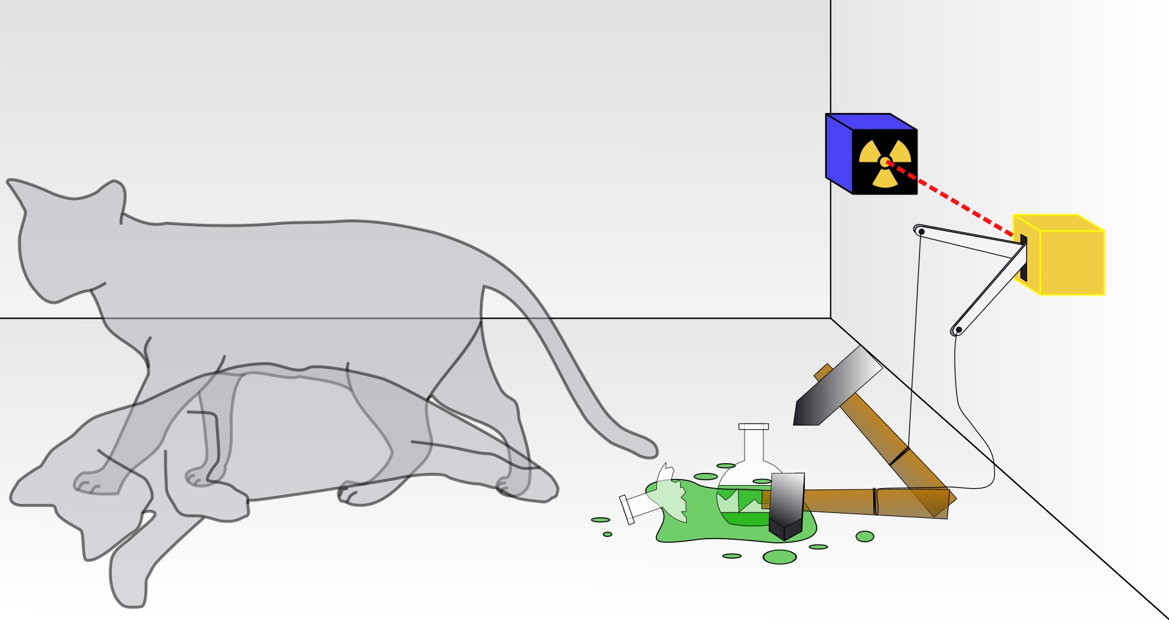
Schrödinger's Null
图片来源：wikipedia.org

Slide 7
ES201x
Set
arrow function
Exponentiation Operator
let
tagged template
const
Generators
class
Map
Promise
spread
TypedArrays
trailing commas
Iteration
Symbol

Slide 8
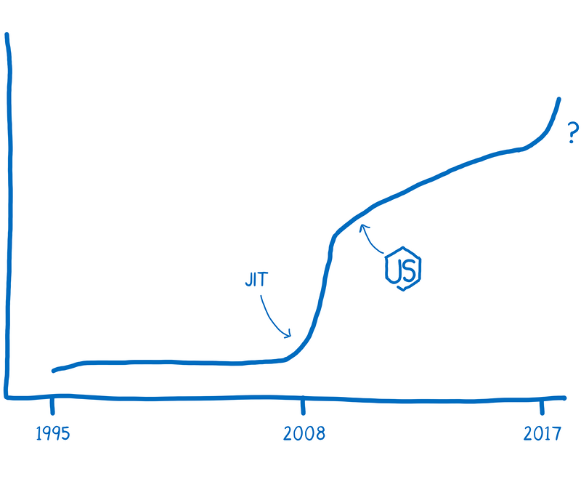

Slide 9





V8 Release Process
每天
每周
每6周
每6周

Slide 10
V8 引擎针对 JavaScript 的性能优化
V8 概览
快速的算术运算
数组的高阶函数
内联编译
逃逸分析

Slide 11



TurboFan
(since Chrome 59)
Ignition

Slide 12
Optimization Killers
生成器和 async 函数
for-of 和数组解构
try-catch 和 try-finally
复合 let 或 const 赋值
包含 __proto、get、set 的对象声明
debugger 或 with 语句
eval()
…
TurboFan

Slide 13
快速的算术运算
const i = 1; // SmallInteger (Smi)
const d = 1.1; // HeapNumber (Double)
const o = {}; // JSObject(Heap)

Slide 14
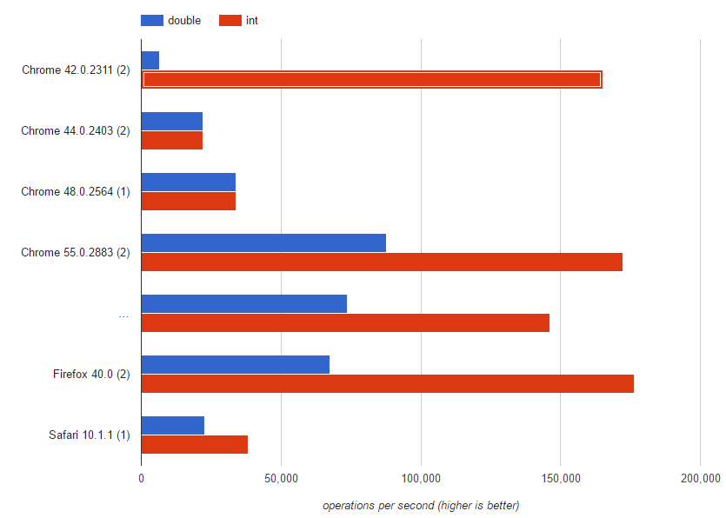
SMI vs Double

Slide 15
代码: a+b
mov eax, a
mov ebx, b
call RuntimeAdd
×

Slide 16
代码: a+b
mov eax, a
mov ebx, b
call RuntimeAdd
add eax, ebx
×
✓

Slide 17
Type feedback
二元运算符可以收集函数的 type feedback 信息.
function f(a, b){ var c = a + a; return b + c;
}
函数信息
StackCheck
Ldar a0
Add a0, [2]
Star r0
Ldar r0
Add a1, [3]
Return
Feedback vector
...
...
2: unitialized
3: unitialized

Slide 18
Type feedback
函数信息
二元运算符可以收集函数的 type feedback 信息.
function f(a, b){ var c = a + a; return b + c;
}
f(1, 2);
StackCheck
Ldar a0
Add a0, [2]
Star r0
Ldar r0
Add a1, [3]
Return
Feedback vector
...
...
int + int -> int
int + int -> int

Slide 19
Type feedback
函数信息
二元运算符可以收集函数的 type feedback 信息.
function f(a, b){ var c = a + a; return b + c;
}
f(1, 2);
f(1, 0.1)
StackCheck
Ldar a0
Add a0, [1]
Star r0
Ldar r0
Add a1, [1.1]
Return
Feedback vector
...
...
int + int -> int
num+num-> num

Slide 20
Type feedback
函数信息
二元运算符可以收集函数的 type feedback 信息.
function f(a, b){ var c = a + a; return b + c;
}
f(1, 2);
f(1, 0.1) // Deopt!!!
StackCheck
Ldar a0
Add a0, [1]
Star r0
Ldar r0
Add a1, [1.1]
Return
Feedback vector
...
...
int + int -> int
num+num-> num

Slide 21


Optimization
x is a Number
Ignition
TurboFan
Deoptimization
x is NOT a Number

Slide 22
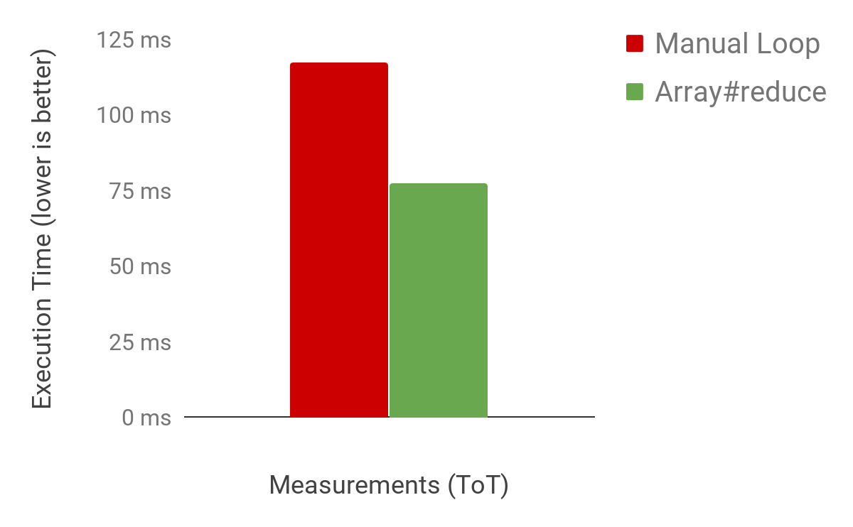
数组的高阶函数

Slide 23
const array = [1, 2, 3];
// elements kind: PACKED_SMI_ELEMENTS
array.push(4.56);
// elements kind: PACKED_DOUBLE_ELEMENTS
array.push('x');
// elements kind: PACKED_ELEMENTS

Slide 24
array.length; // 5
index
0
1
2
3
4
value
1
2
3
4.56
“x”

Slide 25
array.length; // 5
array[9] = 1;
// array[5] ~ array[8]
// elements kind: HOLEY_ELEMENTS
index
0
1
2
3
4
5
6
7
8
9
value
1
2
3
4.56
“x”
1

Slide 26
array[8]; // ???
8 >= 0 && 8 < array.length; // bounds check
hasOwnProperty(array, '8');
hasOwnProperty(Array.prototype, '8');
hasOwnProperty(Object.prototype, '8');

Slide 27
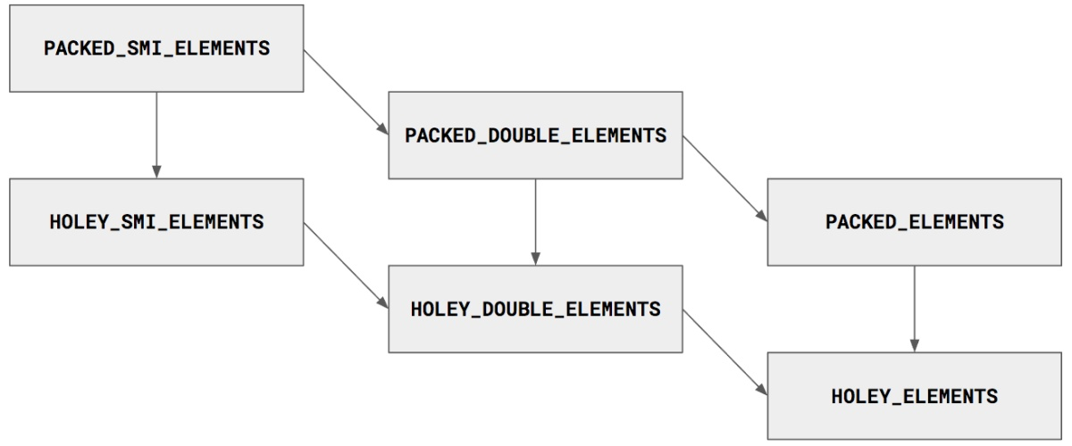

Slide 28
const array = [1, 2, 3];
array.reduce((b, x) => b + x, 0)
= ((0 + 1) + 2) + 3
= 6
对数组的元素进行累加
b 的初始值为 0

Slide 29

function foo(A) {
return A.reduce((b, x) => b + x, 0);
}
function foo_inlined(A) { const f = (b, x) => b + x; const len = A.length; if (typeof f !== "function") { throw new TypeError(); } let b = 0; for (let i = 0; i < len; ++i) { if (i in A) { b = f(b, A[i]); } } return b; }

Slide 30
function Array_reduce_inline(A) {
const f = (b, x) => b + x;
if (typeof f !== "function") {
throw new TypeError();
}
let b = 0;
for (let i = 0; i < A.length; ++i) {
if (i in A) { b = f(b, A[i]); }
}
return b;
}
PACKED_SMI_ELEMENTS

Slide 31
function Array_reduce_inline(A) {
const f = (b, x) => b + x;
if (typeof f !== "function") {
throw new TypeError();
}
let b = 0;
for (let i = 0; i < A.length; ++i) {
if (i in A) { b = f(b, A[i]); }
}
return b;
}
PACKED_SMI_ELEMENTS

Slide 32
function Array_reduce_inline(A) {
const f = (b, x) => b + x;
if (typeof f !== "function") {
throw new TypeError();
}
let b = 0;
for (let i = 0; i < A.length; ++i) {
if (i in A) { b = b + A[i]; }
}
return b;
}
PACKED_SMI_ELEMENTS

Slide 33
function Array_reduce_inline(A) {
let b = 0;
for (let i = 0; i < A.length; ++i) {
if (i in A) { b = b + A[i]; }
}
return b;
}
PACKED_SMI_ELEMENTS

Slide 34
function Array_reduce_inline(A) {
if (A not PACKED_SMI_ELEMENTS) Deopt;
let b = 0;
for (let i = 0; i < A.length; ++i) {
if (i in A) { b = b + A[i]; }
if (A not PACKED_SMI_ELEMENTS) Deopt;
}
return b;
}
PACKED_SMI_ELEMENTS

Slide 35
function Array_reduce_inline(A) {
if (A not PACKED_SMI_ELEMENTS) Deopt;
let b = 0;
for (let i = 0; i < A.length; ++i) {
if (i in A) { b = b + A[i]; }
if (A not PACKED_SMI_ELEMENTS) Deopt;
}
return b;
}
PACKED_SMI_ELEMENTS

Slide 36
function Array_reduce_inline(A) {
if (A not PACKED_SMI_ELEMENTS) Deopt;
let b = 0;
for (let i = 0; i < A.length; ++i) {
if (i in A) { b = b + A[i]; }
if (A not PACKED_SMI_ELEMENTS) Deopt;
}
return b;
}
PACKED_SMI_ELEMENTS

Slide 37
function Array_reduce_inline(A) {
if (A not PACKED_SMI_ELEMENTS) Deopt;
let b = 0;
for (let i = 0; i < A.length; ++i) {
b = b + A[i];
}
return b;
}
PACKED_SMI_ELEMENTS

Slide 38
Inlining
function add(x, y) {
return x + y; }
function three() { return add(1, 2); }
function three_add_inlined() { var x = 1;
var y = 2; var add_return_value = x + y; return add_return_value; }
function three_add_const_folded() {
return 3;
}

Slide 39
function add(x, y) {
return x + y; }
function three() { return add(1, 2); }
leaq rcx,[rip+0x0] movq rcx,[rcx-0x37] testb [rcx+0xf],0x1 jnz CompileLazyDeoptimizedCode push rbp movq rbp,rsp push rsi push rdi cmpq rsp,[r13+0xdb0] jna StackCheck movq rax,[rbp+0x18] test al,0x1 jnz Deoptimize movq rbx,[rbp+0x10] testb rbx,0x1 jnz Deoptimize movq rdx,rbx shrq rdx, 32 movq rcx,rax shrq rcx, 32 addl rdx,rcx jo Deoptimize shlq rdx, 32 movq rax,rdx movq rsp,rbp pop rbp ret 0x18

Slide 40
function add(x, y) {
return x + y; }
function three() { return add(1, 2); }
leaq rcx,[rip+0x0] movq rcx,[rcx-0x37] testb [rcx+0xf],0x1 jnz CompileLazyDeoptimizedCode push rbp movq rbp,rsp push rsi push rdi cmpq rsp,[r13+0xdb0] jna StackCheck movq rdi,<JSFunction add> movq rsi,[rdi+0x1f] movq rax,<JSGlobal Object> push rax movq rax,0x100000000 push rax movq rax,0x200000000 push rax movq rdx,[r13-0x60] movl rax,0x2 movq rcx,[rdi+0x2f] addq rcx,0x5f call rcx movq rsp,rbp pop rbp ret 0x8

Slide 41
leaq rcx,[rip+0x0] movq rcx,[rcx-0x37] testb [rcx+0xf],0x1 jnz CompileLazyDeoptimizedCode push rbp movq rbp,rsp push rsi push rdi cmpq rsp,[r13+0xdb0] jna StackCheck movq rax,[rbp+0x18] test al,0x1 jnz Deoptimize movq rbx,[rbp+0x10] testb rbx,0x1 jnz Deoptimize movq rdx,rbx shrq rdx, 32 movq rcx,rax shrq rcx, 32 addl rdx,rcx jo Deoptimize shlq rdx, 32 movq rax,rdx movq rsp,rbp pop rbp ret 0x18
leaq rcx,[rip+0x0] movq rcx,[rcx-0x37] testb [rcx+0xf],0x1 jnz CompileLazyDeoptimizedCode push rbp movq rbp,rsp push rsi push rdi cmpq rsp,[r13+0xdb0] jna StackCheck movq rdi,<JSFunction add> movq rsi,[rdi+0x1f] movq rax,<JSGlobal Object> push rax movq rax,0x100000000 push rax movq rax,0x200000000 push rax movq rdx,[r13-0x60] movl rax,0x2 movq rcx,[rdi+0x2f] addq rcx,0x5f call rcx movq rsp,rbp pop rbp ret 0x8
leaq rcx,[rip+0x0] movq rcx,[rcx-0x37] testb [rcx+0xf],0x1 jnz CompileLazyDeoptimizedCode push rbp movq rbp,rsp push rsi push rdi cmpq rsp,[r13+0xdb0] jna StackCheck movq rax,0x300000000 movq rsp,rbp pop rbp ret 0x8

Slide 42
escape analysis
function foo(a) {
return abs({x:a, y:a});
}
function abs(v) {
return Math.sqrt(v.x*v.x + v.y*v.y);
}
return Math.sqrt(a*a + a*a);
How ???

Slide 43
Step 1: 内联
function foo(a) {
let v = {x:a, y:a};
return abs(v);
}
function abs(v) {
return Math.sqrt(v.x*v.x + v.y*v.y);
}
function foo(a) {
let v = {x:a, y:a};
return Math.sqrt(v.x*v.x + v.y*v.y);
}

Slide 44
Step 2: 替换属性访问操作
function diagonal(a) {
let v = {x:a, y:a};
return Math.sqrt(v.x*v.x + v.y*v.y);
}
function diagonal(a) {
let v = {x:a, y:a};
return Math.sqrt(a*a + a*a);
}

Slide 45
Step 3: 删除未使用的变量
function diagonal(a) {
let v = {x:a, y:a};
return Math.sqrt(v.x*v.x + v.y*v.y);
}
function diagonal(a) {
return Math.sqrt(a*a + a*a);
}

Slide 46
TC39 的最新提案以及应用场景
TC39 process
BigInt
Pipeline operator
Pattern Matching

Slide 47
TC39 process
共包含 5 个阶段
使用 HTML 的超集进行格式化
基于 GitHub pull requests

Slide 48
Stage
Babel
strawman
draft
finished
Stage 0
Stage 2
Stage 4
Stage 1
Stage 3
proposal
candidate
polyfill 和 demo

Slide 49
Stage2+
准备实现
写设计文档
原型设计
Baseline
优化
公测
Shipped
Staged
调试

Slide 50
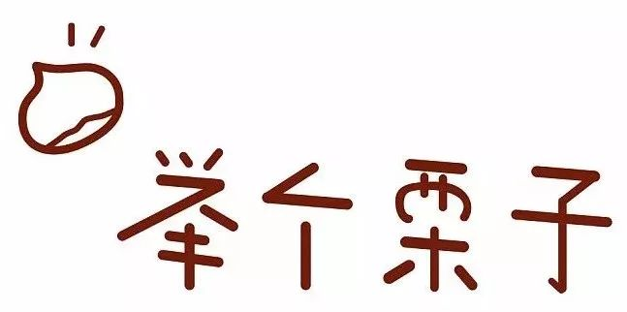

Slide 51
Proxy
Chrome 49 开始支持 Proxy
Chrome 62 改进了 Proxy 的性能

Slide 52
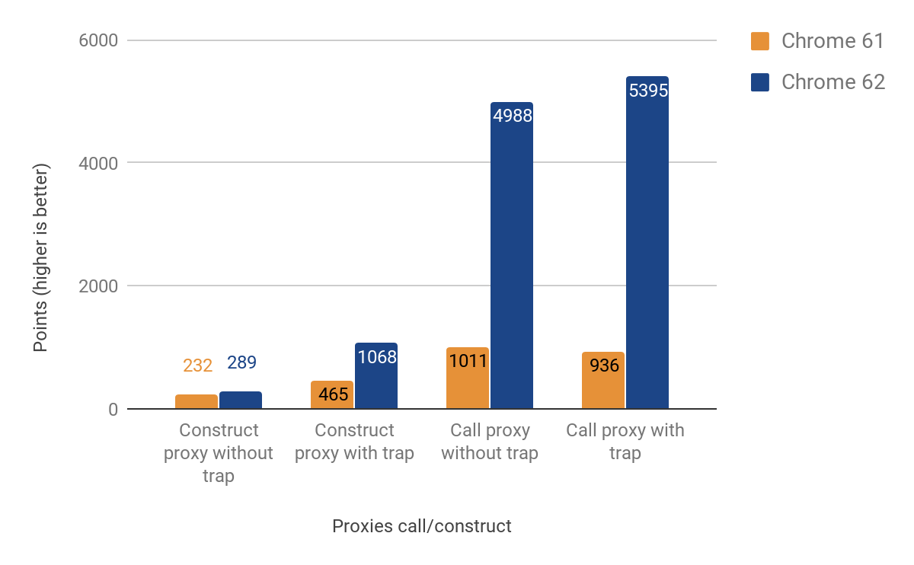
Proxy 构造函数

Slide 53
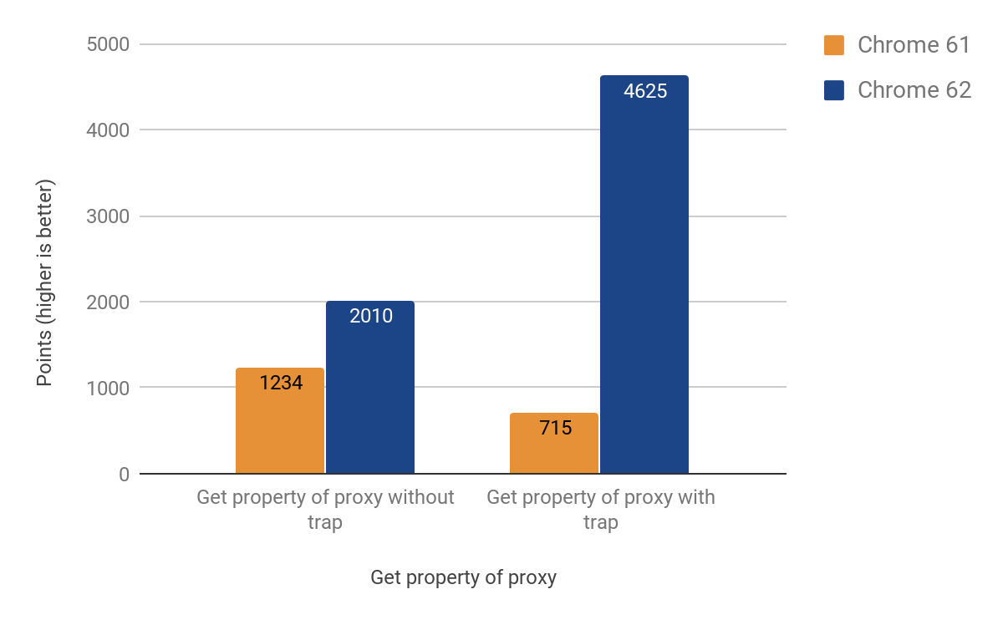
Proxy 获取属性值

Slide 54
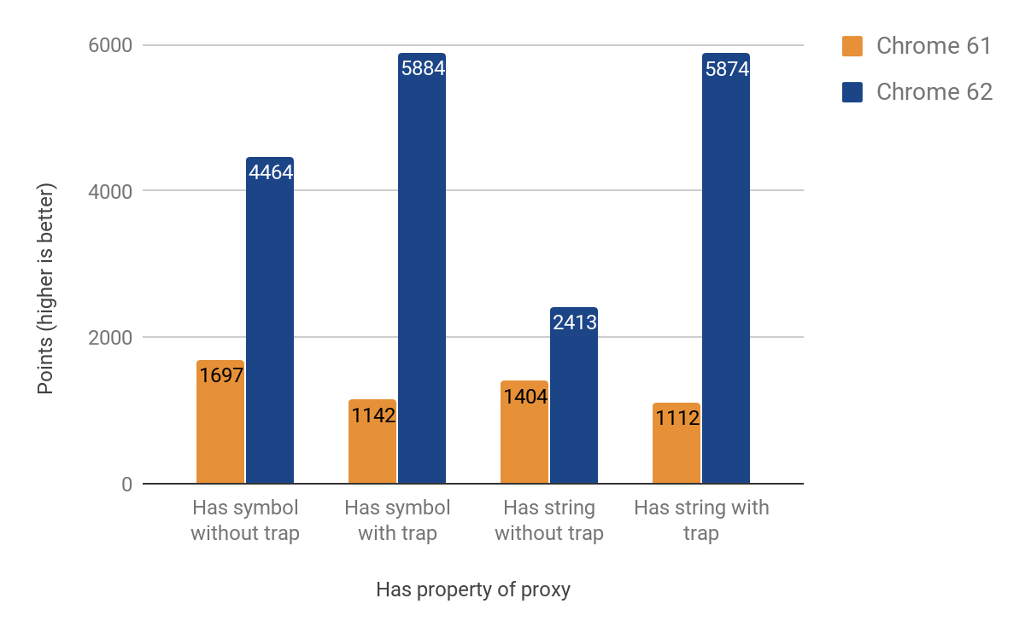
Proxy 判断属性值

Slide 55
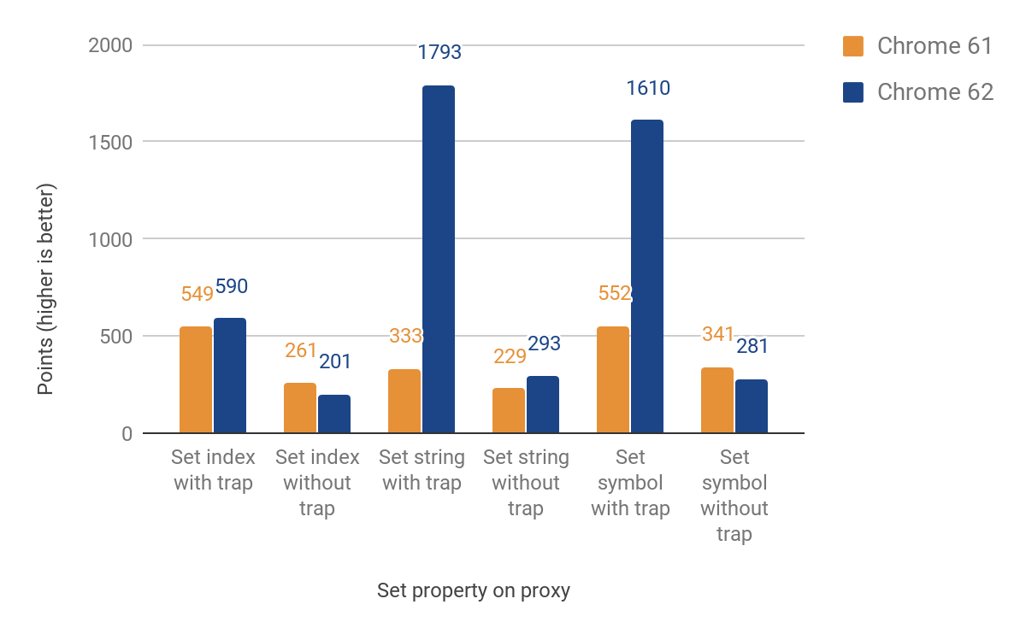
Proxy 设置属性值

Slide 56
Proxy 性能提升
24% ~ 546%

Slide 57

BigInt

Slide 58
const max = Number.MAX_SAFE_INTEGER; // → 9,007,199,254,740,991 (= 2**53-1)

Slide 59
const max = Number.MAX_SAFE_INTEGER; // → 9,007,199,254,740,991 (= 2**53-1) max + 1; // → 9,007,199,254,740,992 (= 2**53)

Slide 60
const max = Number.MAX_SAFE_INTEGER; // → 9,007,199,254,740,991 (= 2**53-1) max + 1; // → 9,007,199,254,740,992 (= 2**53) max + 2; // → 9,007,199,254,740,992 (= 2**53)

Slide 61
const max = Number.MAX_SAFE_INTEGER; // → 9,007,199,254,740,991 (= 2**53-1) max + 1; // → 9,007,199,254,740,992 (= 2**53) max + 2; // → 9,007,199,254,740,992 (= 2**53) max + 3; // → 9,007,199,254,740,994 (= 2**53+2)

Slide 62
const max = Number.MAX_SAFE_INTEGER; // → 9,007,199,254,740,991 (= 2**53-1) max + 1; // → 9,007,199,254,740,992 (= 2**53) max + 2; // → 9,007,199,254,740,992 (= 2**53) max + 3; // → 9,007,199,254,740,994 (= 2**53+2)
BigInt(max) + 2n; // → 9,007,199,254,740,993n (= 2**53+1)

Slide 63
1234567890123456789 * 123; // → 151851850485185200000
1234567890123456789n * 123n; // → 151851850485185185047n

Slide 64
typeof 123;
// → 'number'
typeof 123n;
// → 'bigint'

Slide 65
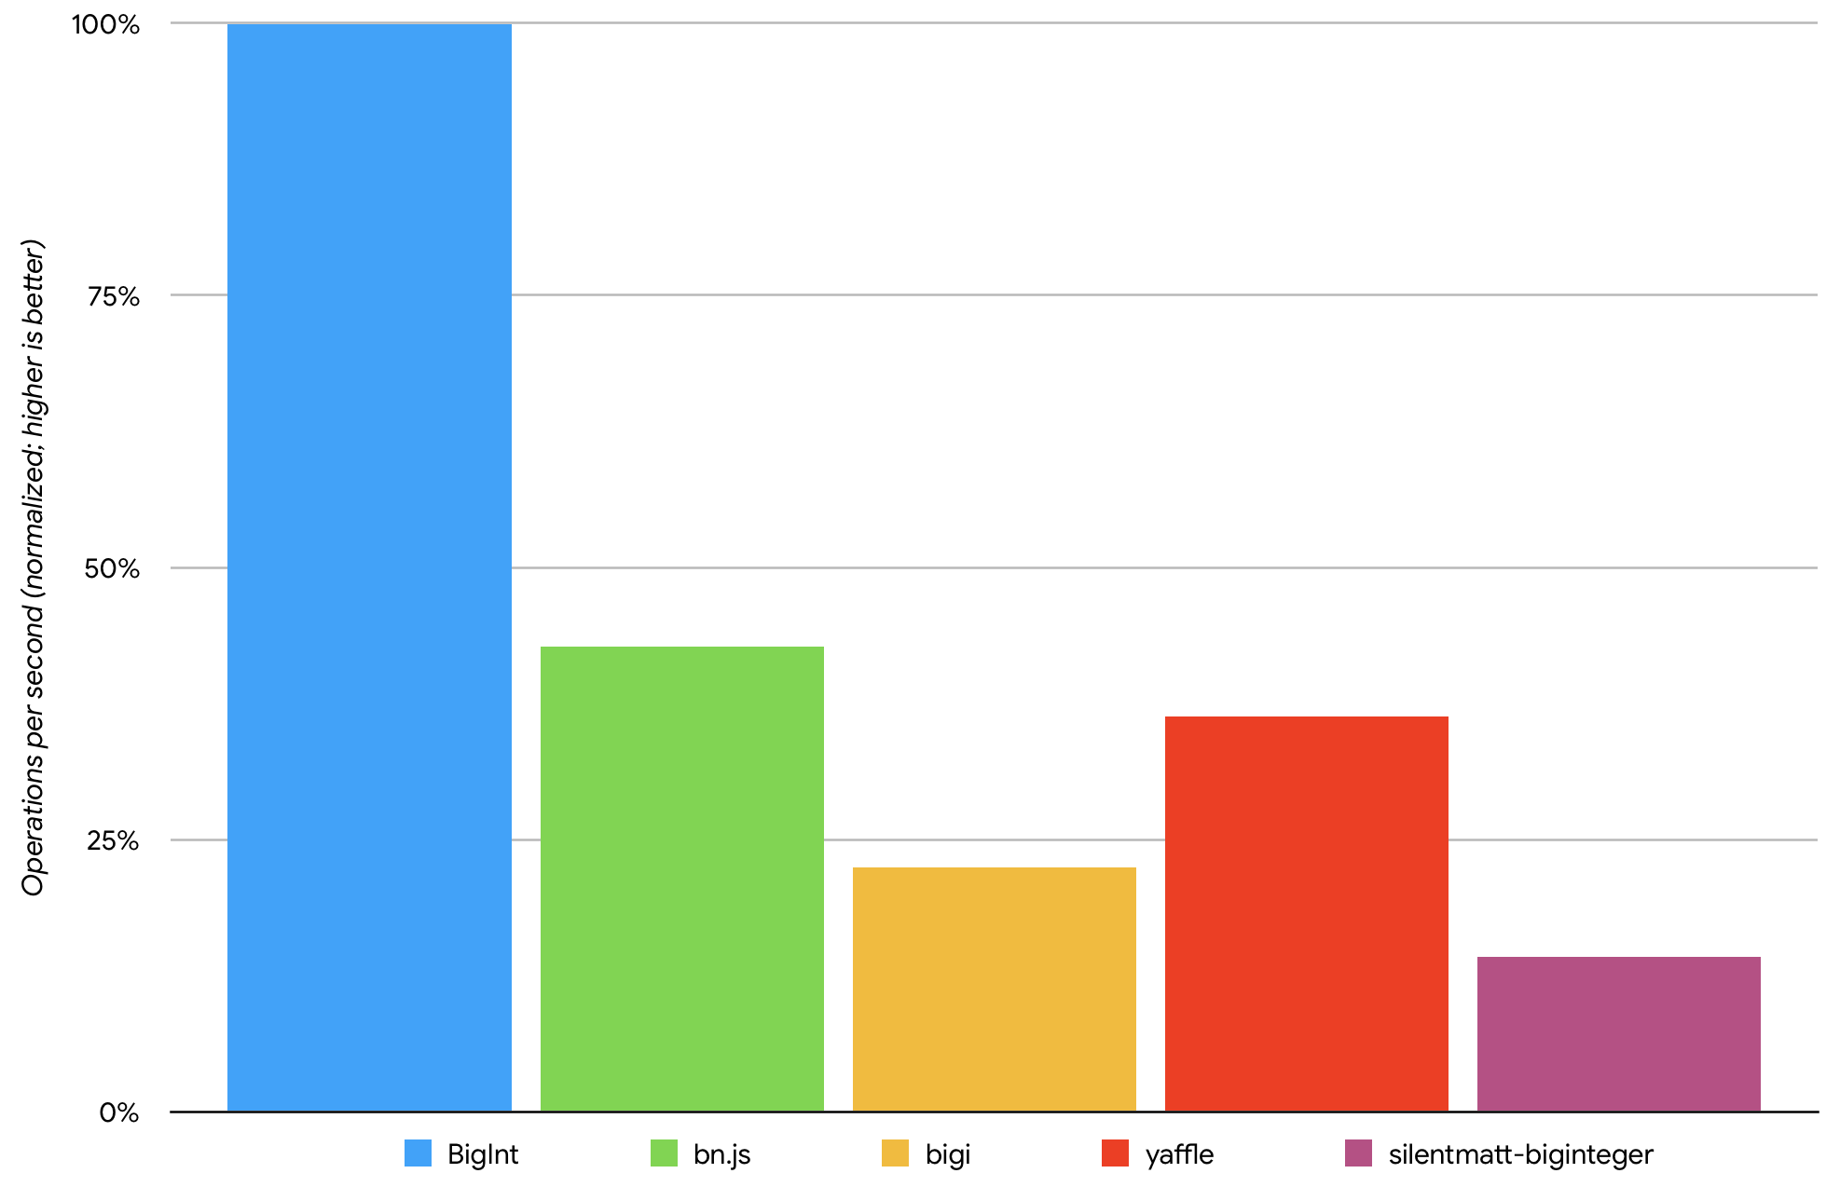

Slide 66
Pipeline operator
Stage-1

Slide 67
log(capitalize(double("hello")))
log( capitalize( double ( "hello" ) ) )
"hello" |> double |> capitalize |> log

Slide 68
new User.Message(
capitalize(
doubledSay(value, ', ')
) + '!' )
value
|> (x => doubleSay(x, ', '))
|> capitalize
|> (x => x + '!')
|> (x => new User.Message(x))

Slide 69
Optional Chaining
Stage 1

Slide 70
// 获取用户 name 属性
// 可能抛出异常
const name = response.body.user.name;

Slide 71
// 获取用户 name 属性
// 可能抛出异常
const name = response.body.user.name;
// 对变量和属性进行检查 const name = response
&& response.body

Slide 72
// 获取用户 name 属性
// 可能抛出异常
const name = response.body.user.name;
// 对变量和属性进行检查 const name = response
&& response.body
&& response.body.user

Slide 73
// 获取用户 name 属性
// 可能抛出异常
const name = response.body.user.name;
// 对变量和属性进行检查 const name = response
&& response.body
&& response.body.user
&& response.body.user.name

Slide 74
// 获取用户 name 属性
// 可能抛出异常
const name = response.body.user.name;
// 对变量和属性进行检查 const name = response
&& response.body
&& response.body.user
&& response.body.user.name || 'justjavac';

Slide 75
With Optional Chaining
const name = response?.body?.user?.name || 'justjavac';

Slide 76
Pattern Matching
Stage 1

Slide 77
case (input) {
when 1 -> ... // matches if `input` is 1
when 'foo' -> ... // matches if `input` is 'foo'
when false -> ... // matches if `input` is `false`
when null -> ... // matches if `input` is `null`
when {x: 1} -> ... // matches if `input` can do ToObject and `input.x` is 1
when [1,2] -> ... // matches if `input` can do GetIterator, has exactly 2 items,
// and the items are 1, then 2.
when x -> ... // always matches
when /^foo/ -> ... // SyntaxError
when x if (x.match(/^foo/)) -> ... // ok!
}

Slide 78
Redux reducers
function todoApp (state = initialState, action) {
case (action) {
when {type: 'set-visibility-filter', filter: visFilter} ->
return {...state, visFilter}
when {type: 'add-todo', text} ->
return {...state, todos: [...state.todos, {text}]}
when {type: 'toggle-todo', index} -> {
return {
...state,
todos: state.todos.map((todo, idx) => idx === index ? {...todo, done: !todo.done} : todo)
}
}
when {} -> {} // ignore unknown actions
}
}

Slide 79
编写高性能 JavaScript 代码
不要修改原型链
使用 Object.keys()
不要在遍历时修改元素

Slide 80
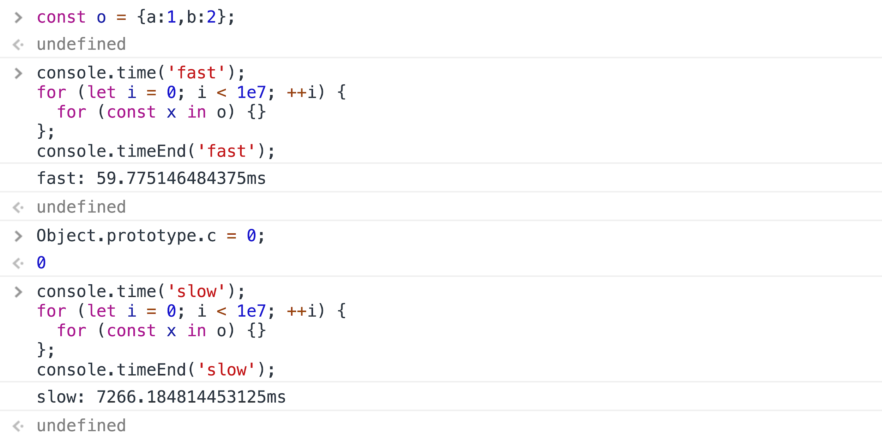
不要修改原型链

Slide 81
不要修改原型链

Slide 82
不要修改原型链

Slide 83
不要修改原型链
100x

Slide 84
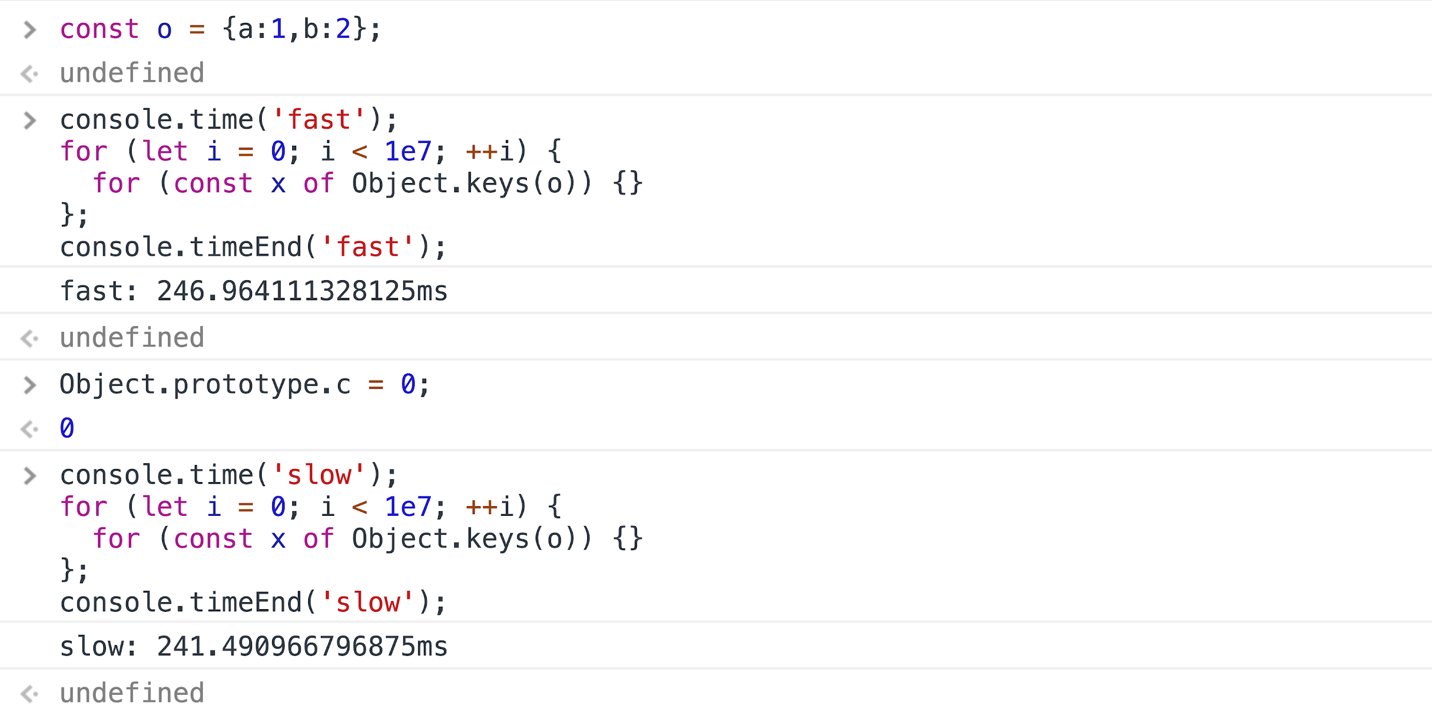
Object.keys()

Slide 85
Object.keys()
1x

Slide 86
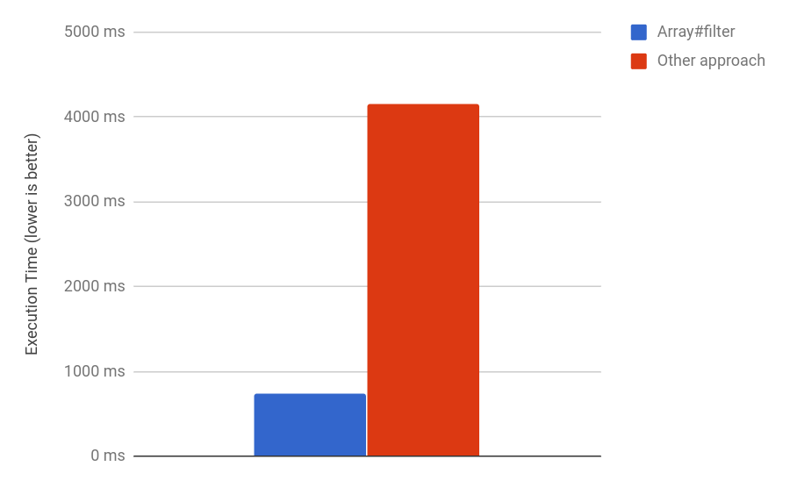
不要在遍历时修改元素
A.filter((x, i) => x > 50); // OK
A.forEach((x, i) => {
if (x > 50) A[i] = undefined;
});

Slide 87
JavaScript函数式编程

Slide 88
函数式编程都是垃圾

